Slide 1

2024
Laser Cutting Machine Solution
Mode: TF 3015 Edge
Reporter：Benny Liu
Date ：20240422
Version ：V2.1
上海睿镭智能科技有限公司
Shanghai Raylaser Intelligent Technology Co.,Ltd.
· 第1页 ·

Slide 2
Contents
Contents
1
Machine Configuration
2
Cutting Parameters
3
Machine mechanical performance
4
Machine features & advantages
5
Machine operating cost
6
Spare parts and consumables
7
Applications
8
Quotation
9
Partners and customers
10
With Customers
· 第 2 页 ·

Slide 3
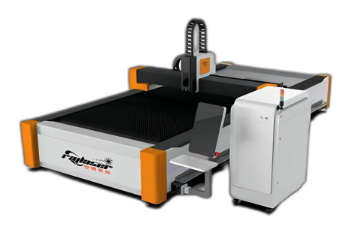
1
Machine Configuration
Product Overview
Shanghai Raylaser Intelligent’s TF series is a perfect blend of cost-efficiency and flexibility to boost your productivity.
Recommended configuration TF 3015 Edge with laser power 1500W, and the cutting area recommend is 3000mm length and 1500mm width.
TF 3015 Edge is fast. Precise. And super easy to operate.
Over 17 years in laser cutting applications and hundreds of units deployed in the field, we know what our customers expect and demand, and work diligently to exceed those expectations.
Product Advantages:
Cost-efficiency
Space-saving design
Versatility
Ease of use
Enhanced productivity
High Quality by Shanghai Raylaser
Laser Cutting Machine for Plate Metal
Model: TF 3015 Edge
· 第页 ·
www.ray-laser.com

Slide 4
1
Machine Configuration
Shanghai Raylaser’s Commission:
Focus on Laser Applications
Create Value for Customers
At Raylaser, Be RAYLASER, Share Raylaser!
Real customized and reliable Solutions and Services
Automation and more efficient working station empowerment
Your one stop partner for laser cutting, welding applications
Lean manufacturing oriented supporting and partnership
Advanced thinking and proactive steps for High OEE Benefits
Systematically TPM consultancy and advice for lower operating cost
Easy to use and integrated
Relationship building and lasting for better Business Development
Laser Cutting Machine for Plate Metal
Model: TF 3015 Edge
· 第页 ·
www.ray-laser.com

Slide 5
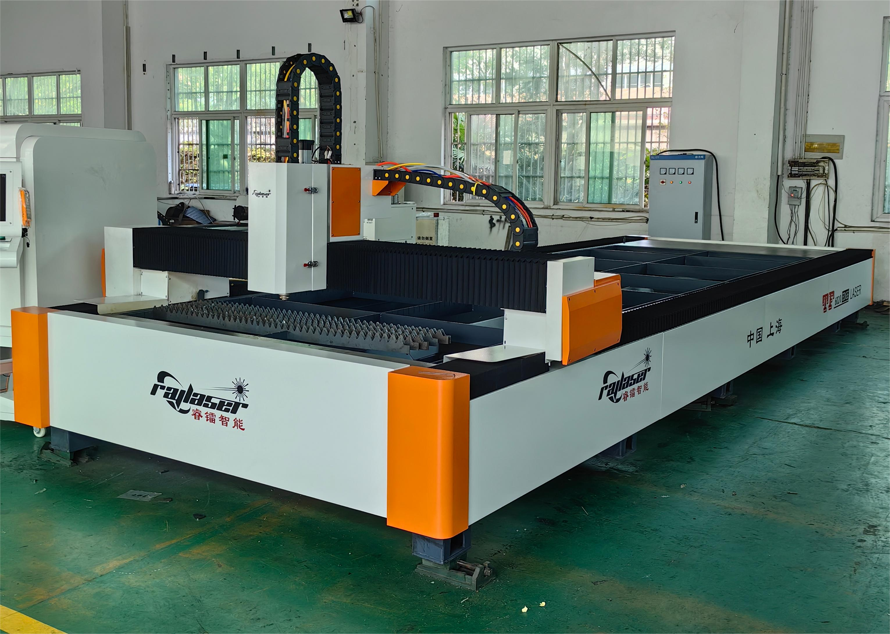
1
Machine Configuration
Machine Configuration As Inquiry
● Standard ◎ Optional
Key parts | Specifications | Status
System | Bochu Cypcut | ●
Reducer | MOTOVARIO | ●
Rack and Pinion | LEADER/YYC | ●
Rail guideway | HIWIN | ●
Servo Motor (1300w*2+850w+400w) | Yaskawa | ●
Electrical proportional valve | O₂（<10bar） | ●
Laser source | Raycus, Max, IPG,GW 1500W | ●
Laser cutting head | Raytools/OSPRI | ●
Standard electrical parts | Schneider/Shanghai Electric | ●
Chiller | Hanli/S&A | ●
Voltage Regulator | optional | ◎
Intelligent dust removal system | optional | ◎
Air Compressor | TANOP Series | ◎
Cutting gas control valve O2 | optional | ◎
Cutting gas control valve N₂ | optional | ◎
Laser Cutting Machine for Metal Plate
Model: TF 3015 Edge
· 第页 ·
www.ray-laser.com

Slide 6
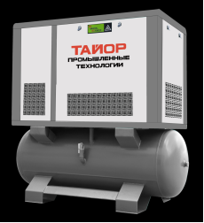
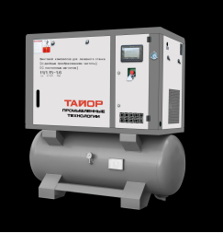
1
Machine Configuration
Recommanded Air Compressor
The individual branding TANOP series of air compressor from Shanghai Raylaser is our leading industrial product designed for Laser Cutting Machine with reliable and high quality compressed air that matters.
The Benefits
Tailored Compressed Air Solutions
High-Quality Compressed Air
Reliable air
Lower operating expenses
High Ambient Operation
· 第页 ·
www.ray-laser.com

Slide 7
2
Cutting Parameters
MFSC-1500(50μm) Cutting Parameter
Material | Thickness （mm） | Auxilliary | Speed （m/min） | Power （W） | Burst Freq. （Hz） | Duty Cycle （%） | Pressure （bar） | Follow Height （mm） | Focal Position | Nozzle Type
Mild Steel | 1 | N2/Air | 20~22 | 1000 | 5000 | 100 | 12~16 | 0.5 | 0 | Single：1.0
 | 2 | N2 | 6~7 | 1000 | 5000 | 100 | 12~16 | 0.5 | 0~-0.5 | Single：1.5
 | 3 | O2 | 2.8~3 | 1000 | 5000 | 100 | 0.6~0.9 | 0.8 | 4.5~5.5 | Double：1.2
 | 4 | O2 | 2.2~2.4 | 1000 | 5000 | 100 | 0.6~0.9 | 1.5 | 2~3 | Double：2.0
 | 5 | O2 | 1.5~1.7 | 1000 | 5000 | 100 | 0.6~0.9 | 1.5 | 2~3 | Double：2.5
 | 6 | O2 | 1.2~1.4 | 1000 | 5000 | 100 | 0.6~0.9 | 1.5 | 2~3 | Double：3.0
 | 8 | O2 | 1.0~1.1 | 1000 | 5000 | 100 | 0.6~0.9 | 1.5 | 2~3 | Double：3.0
Stainless Steel | 1 | N2/Air | 21~23 | 1000 | 5000 | 100 | 12~16 | 0.5 | 0 | Single：1.0-1.5
 | 2 | N2/Air | 6.5~7 | 1000 | 5000 | 100 | 12~16 | 0.5 | 0~-0.5 | Single：1.5-2.0
 | 3 | N2/Air | 2.3~2.5 | 1000 | 5000 | 100 | 12~16 | 0.5 | -1~-1.5 | Single：2.0-3.0
 | 4 | N2/Air | 1.4~1.6 | 1000 | 5000 | 100 | 12~16 | 0.5 | -2~-2.5 | Single：3.0
Aluminum | 1 | N2/Air | 15~17 | 1000 | 5000 | 100 | 12~16 | 0.5 | 0 | Single：1.0-1.5
 | 2 | N2/Air | 3.5~4 | 1000 | 5000 | 100 | 12~16 | 0.5 | 0~-0.5 | Single：1.5-2.0
 | 3 | N2/Air | 1.4~1.6 | 1000 | 5000 | 100 | 12~16 | 0.5 | 0~-0.5 | Single：2.0-3.0
Copper | 1 | N2/Air | 13~15 | 1000 | 5000 | 100 | 12~16 | 0.5 | 0 | Single：1.0-1.5
 | 2 | N2/Air | 3~3.5 | 1000 | 5000 | 100 | 12~16 | 0.5 | 0~-0.5 | Single：1.5-2.0
 | 3 | N2/Air | 0.9~1.1 | 1000 | 5000 | 100 | 12~16 | 0.5 | 0~-0.5 | Single：2.0-3.0
· 第页 ·

Slide 8
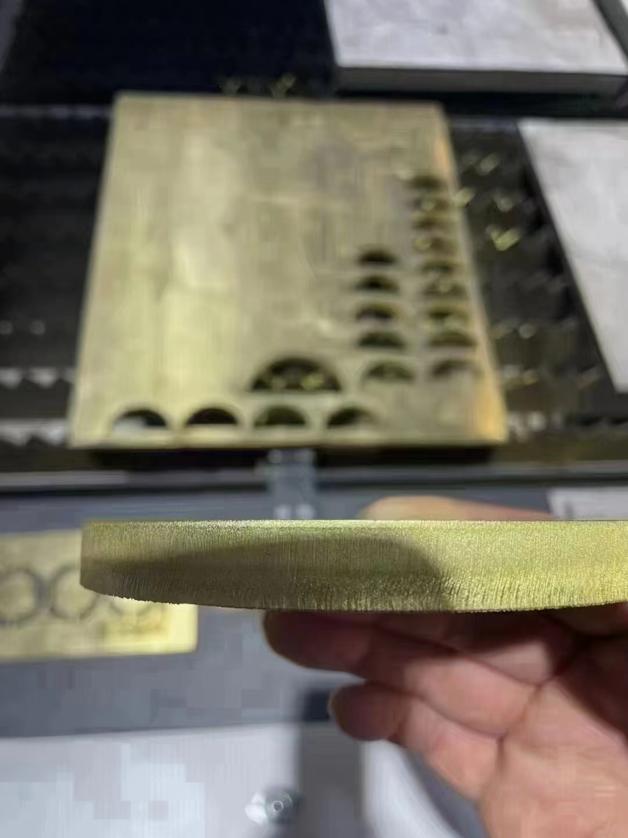
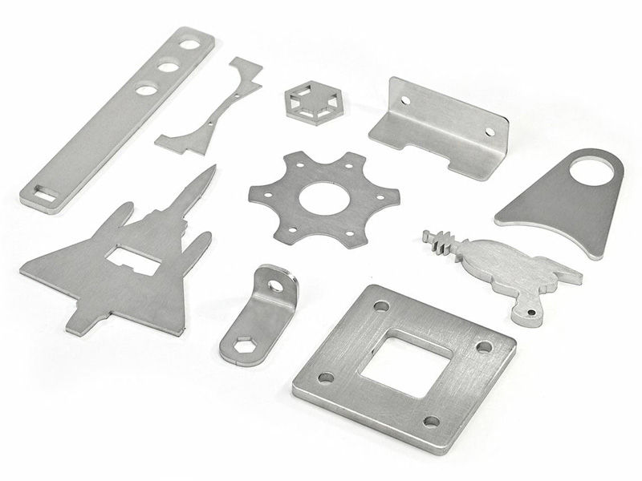
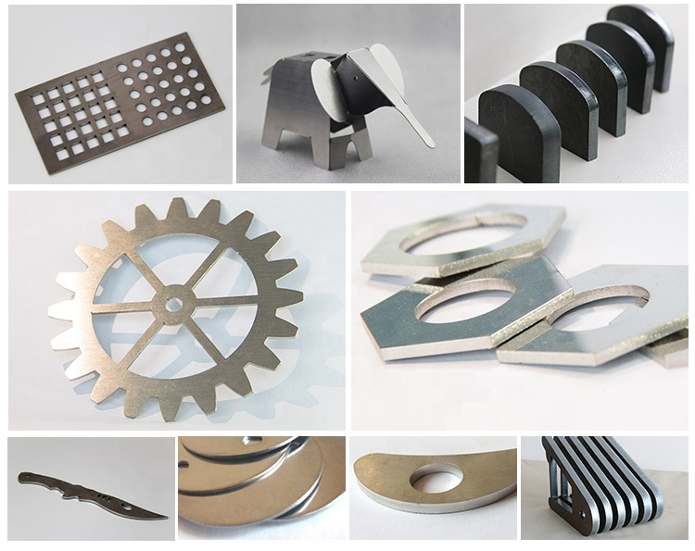
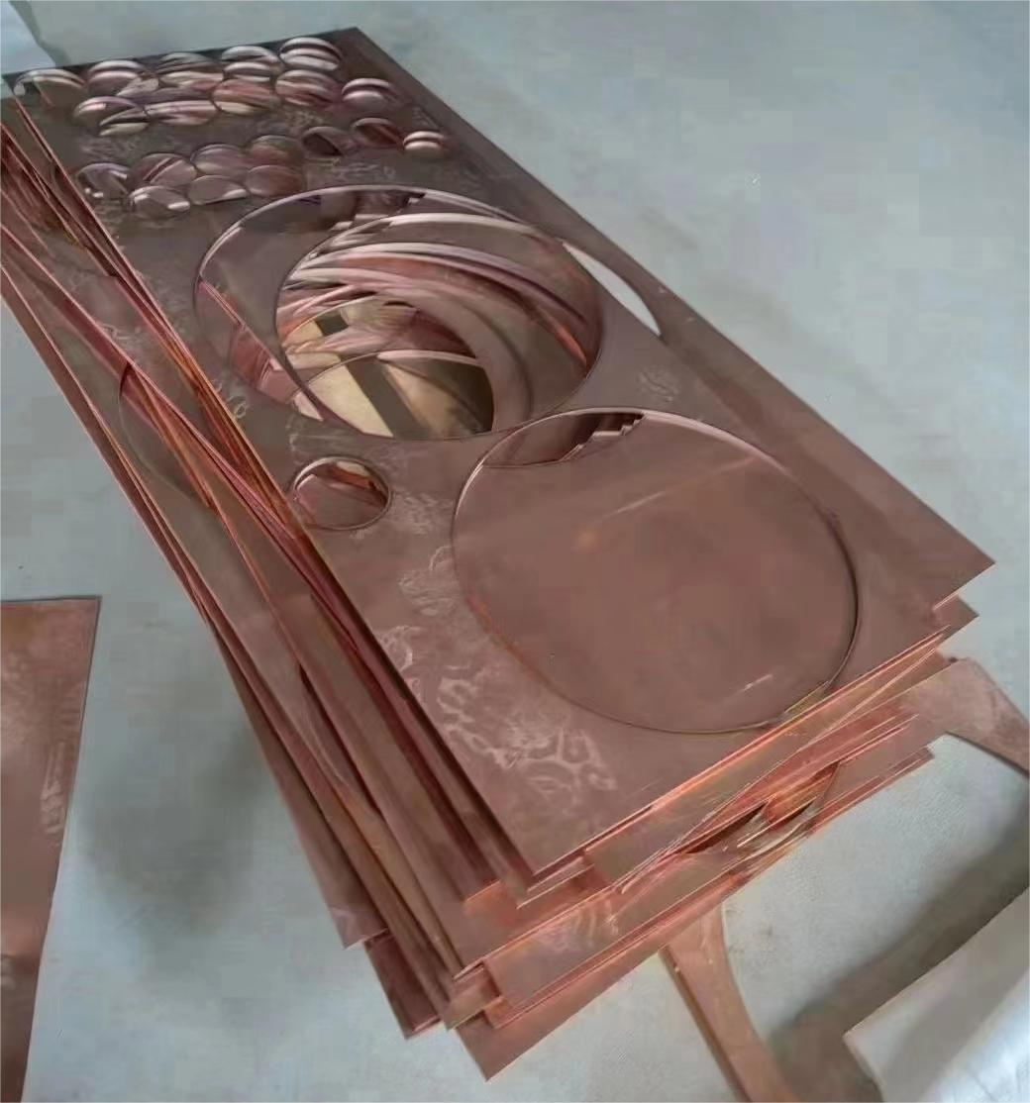
2
Cutting Sample
Customer’s Cutting Parts
· 第页 ·

Slide 9
3
Machine Mechanical Performance
Technical Data
No. | Key Performance | Specification
1 | Working area | 3000mm×1500mm
2 | X axis length | 1510mm
3 | Y axes length | 3010mm
4 | Z axis length | 300mm
5 | Positioning accuracy | ≤0.03mm
6 | Repeat positioning accuracy | ≤0.02mm
7 | Max.accumulated speed | 100m/min
8 | Max.Acceleration | 1.2G
9 | Load Bearing Capacity | 1500KG
10 | Overall weight | 2200Kg
11 | Machine overall dimensions | L4800mm*W2600mm*H1860mm
12 | Power supply | AC380V/50Hz/≤50KVA
13 | Rating | IP54
· 第页 ·
www.ray-laser.com

Slide 10
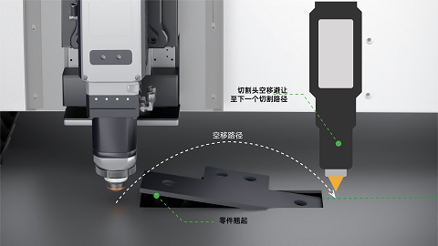
4
Machine Features & Advantages
The Preactive anti-collision function by Boci are option.
Effective Laser Cutting Head Collision Protection
All customers want to avoid mechanical damage by collision!
Effective collision protection can minimize the machine downtime.
This innovative feature improves workflow and minimizes down time, allowing operators to achieve high-quality laser-cut products more efficiently.
Other Key Features:
Dust-proof design with three protection windows
Modular catridge of focus protection widnow is convenient for maintenance.
Focus change by collimation lens movement
Lightning piercing to save time up to 30%
· 第页 ·
www.ray-laser.com

Slide 11
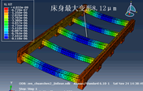
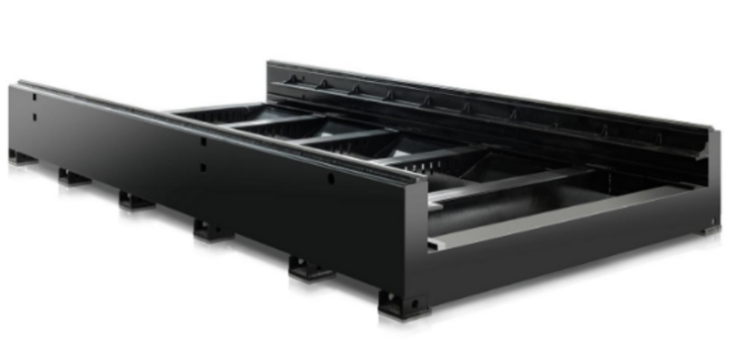
4
Machine Features & Advantages
Heavy Duty Mortise-and-Tenon structure machine bed
The Heavy Duty Mortise-and-Tenon Structure machine bed is an ideal investment for professional manufacturing seeking enhanced performance and efficient laser cutting.
Features:
Thermal Stress Relief without machine deformation
600 degrees stress relief annealing process
Corrosion resistance
Oxidation resistance
High Rigid and Reliability
· 第页 ·
www.ray-laser.com

Slide 12
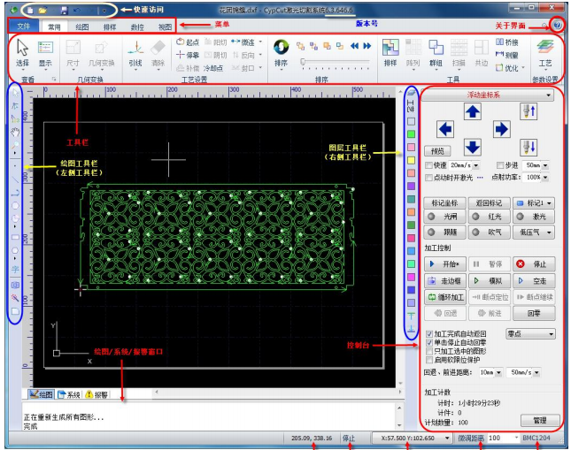
4
Machine Features & Advantages
High precision moving system, Super performance
HiWin linear high precision stainless steel guide rails & bearings
Superior performance servo motors & reducer
YYC rack and pinion
Offering high-precision transmission.
The rack and linear guides are heat-treated with high rigidity and wear resistance, and can work under high torque requirements Smoothly with Low noise.
The Cutting system is easy to install and debug with excellent performance and complete solution.
Support Fly-cut, frog-leap, auto-focus adjustment and dual-shuttle functions
Benefits
Frame Border Contour: Frame profiled plate
One-Path FlyCut: Supported for all figures to improve efficiency
Circle Center: Auto center on circular plate and start cutting
Path accuracy 0.01mm, positioning accuracy 0.02 mm, repetitive positioning accuracy 0.02 mm.
Unlimited cutting/travel speed
Maximum acceleration 1.2G
· 第页 ·
www.ray-laser.com

Slide 13
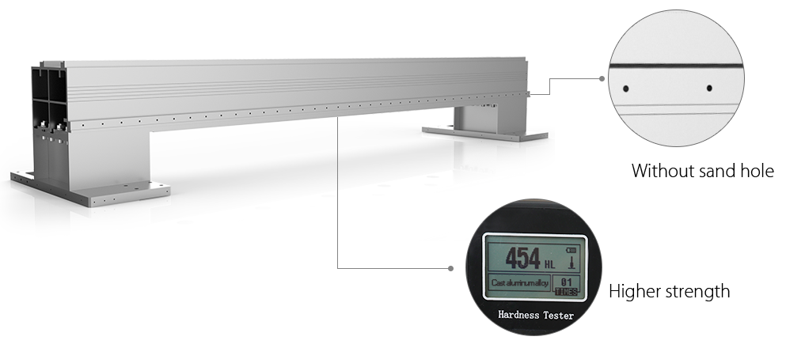
4
Machine Features & Advantages
Aviation Grade Alluminum Gantry
Aerospace aluminum's ultralight weight is a definite advantage, as it can significantly reduce the weight of a gantry.
Additionally, this material's rigidity increases the stiffness and stability of a structure, making it a vital component in critical applications where lightweight and durability are of utmost importance.
· 第页 ·
www.ray-laser.com

Slide 14
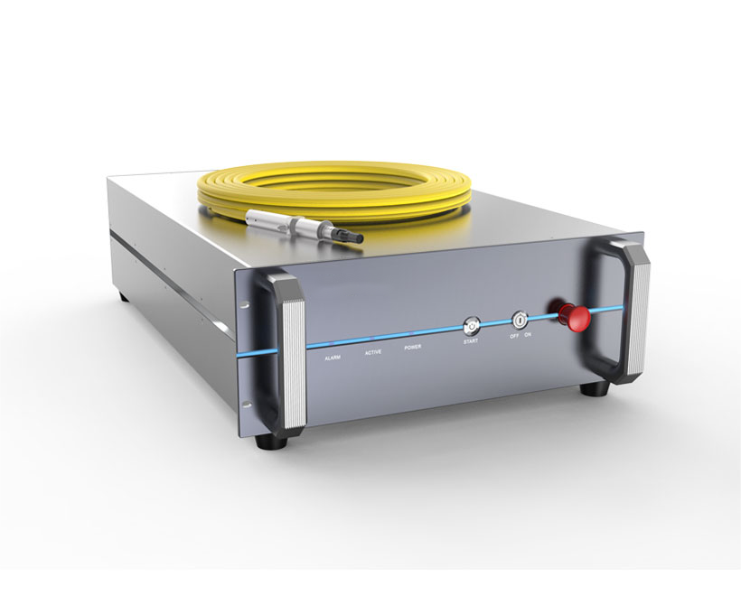
4
Machine Features & Advantages
Fiber Laser Source:
Raylaser are widely recognized by the market for material processing and other applications. which increase the processing speed and cut-edge quality. Meanwhile improving the overall processing capacity, while saving material, time, operating costs, and low maintenance.
Product Feature:
CW Single Module Series with 1.5KW Output
Better beam quality Greatly improved efficiency Excellent Material Processing Performance High speed in thin sheet cutting Strong capability in thick material processing Compact Design, Maintenance Free Highly integrated system with modular design Easy maintenance significantly reduce TCO Smaller Size with Higher Stability >60% reduction in volume Higher flexibility when integrated in to system High Level Vertical Integration All key components are designed and produced in house Strict quality control, high consistency and reliability
· 第页 ·
www.ray-laser.com

Slide 15
4
Machine Features & Advantages
Laser Source Specifications
Models | MFSC-1500W
OPTICAL SPECIFICATIONS
Nominal Power | 1500W
Mode of Operation | CW/Modulated
Polarization | Random
Power Tunability | 10 to100%
Wavelength | 1080±10nm
Power Stability | ±1 %
Laser Beam Quality,BPP | 1.1 to 1.5mm xmrad(50um QBH)
 | 2.8 to 3.6mm xmrad(100um QBH)
Modulation Frequency | ≤ 5kHz
Preview RedLight Power | 200μW
FIBER DELIVERY SYSTEM
Interface | QBH(LOC)
Length | 20 mstandard, other lengths optional
Diameter | 50(100/200)μm
Bending Radius | 200mm
ELECTRICAL RATINGS
Supply Voltage | 400VAC(-15% to +10%) 3-phase
OTHER SPECIFICATIONS
Operating Temperature | +10 to+40℃
Storage Temperature | -10 to+60℃
Humidity | 10 to 85%
Cooling Method | Water Cooling
Cooling Medium | Distilled water/ Glycol Antifreeze
Dimension | 482.6×800×193 mm
Weight | 50(±3)kg
· 第页 ·
www.ray-laser.com

Slide 16
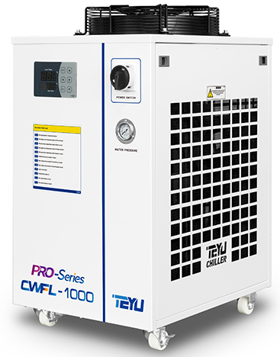
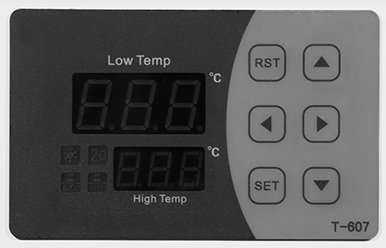
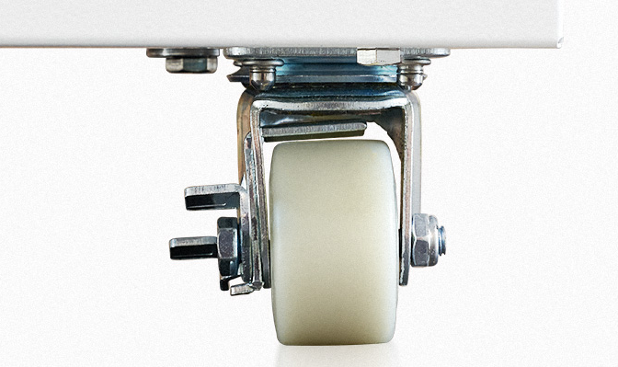
4
Machine Features & Advantages
Model: CWFL-1500
* Dual cooling circuit
* Active cooling
* Temperature stability: ±0.5°C
* Temperature control range: 5°C ~35°C
* Refrigerant: R-410a
* Intelligent digital control panel
* Integrated alarm functions
* Back mounted fill port and easy-to-read water level check
* RS-485 Modbus communication function
* High reliability, energy efficiency and durability
* Available in 380V or 220V (optional)
· 第页 ·
www.ray-laser.com

Slide 17
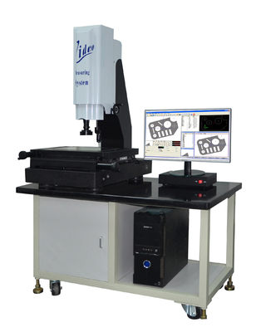
4
Machine Features & Advantages
Quality control measures in production
1) Laser Collimator
Guarantee the Dual Rack’s parallel and straighness.
2) Dial Indicator
Assure the rack and pinion’s completed connection.
3) Laser Interferometer
Control the working area is fairly even level.
4)Second-dimensional Image Measuring Instrument
Recheck the part’s right shape as required and reaffirm the machine’s function
· 第页 ·
www.ray-laser.com

Slide 18
5
Machine Operating Cost
Machine Operating Cost
Item Power | Machine （KW） | Average Hourly Consumption （KW） | Electricity （usd/KWH） | Consumable （usd/h） | Thickness （mm） | GAS | Gas Consumption （usd/h） | Hourly Cost （usd/h）
1KW | 27.3 | 16.38 | 0.13 | 0.36 | CS5 | O2 | 0.97 | 3.45
 |  |  |  |  |  | N2 | 5.53 | 8.01
 |  |  |  |  |  | Air | 1.76 | 4.24
1.5KW | 28.5 | 17.1 |  | 0.45 | CS5 | O2 | 0.97 | 3.65
 |  |  |  |  |  | N2 | 5.53 | 8.21
 |  |  |  |  |  | Air | 1.76 | 4.52
2KW | 30.5 | 18.3 |  |  | CS5 | O2 | 0.97 | 3.85
 |  |  |  |  |  | N2 | 5.53 | 8.41
 |  |  |  |  |  | Air | 1.76 | 4.64
· 第页 ·
www.ray-laser.com

Slide 19
6
Spare Parts and Consumables
Spare Parts for Free With Shipment
No. | Parts | unit | qty | Remark
1 | Nozzle | pcs | 10 | Free
2 | Ceramic | pcs | 1 | Free
3 | Protective lens | pcs | 5 | Free
4 | Lubricating Oil | pcs | 1 | Free
5 | Cleanroom Wipper | pcs | 1 | Free
6 | Dust-free Purification Cotton Swab | pcs | 1 | Free
7 | Ethnol Absolute | pcs | 1 | Free
· 第页 ·
www.ray-laser.com

Slide 20
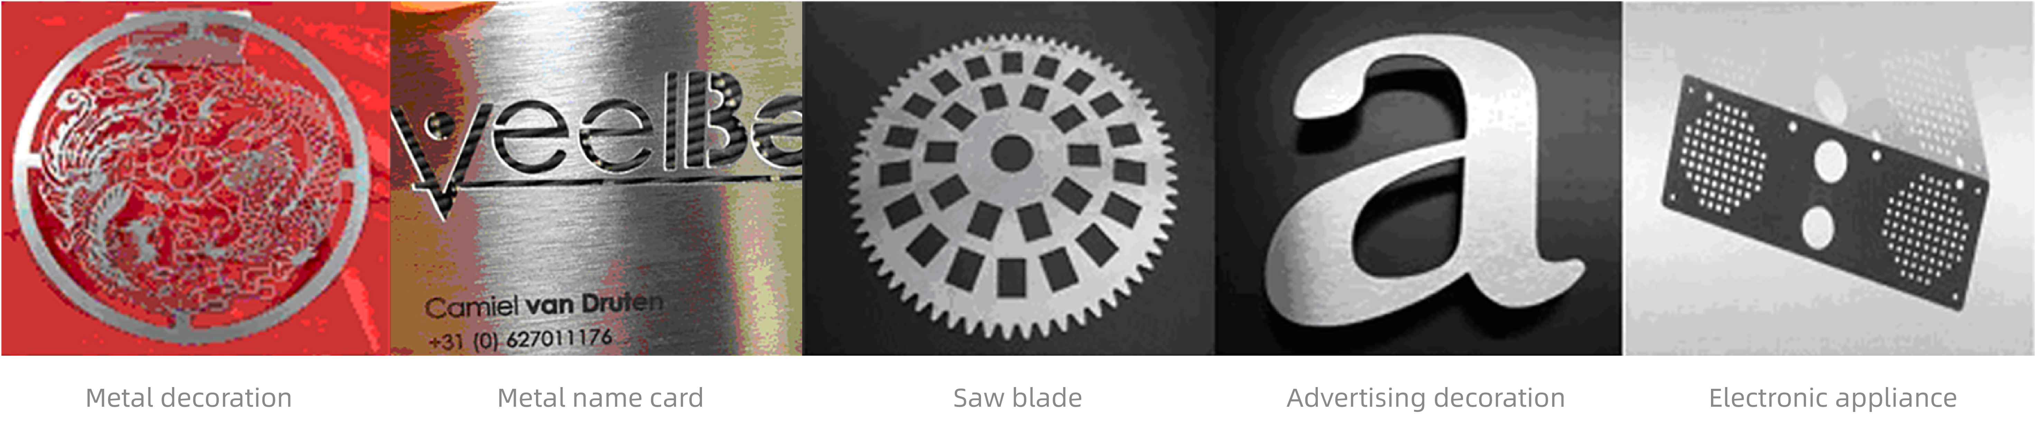
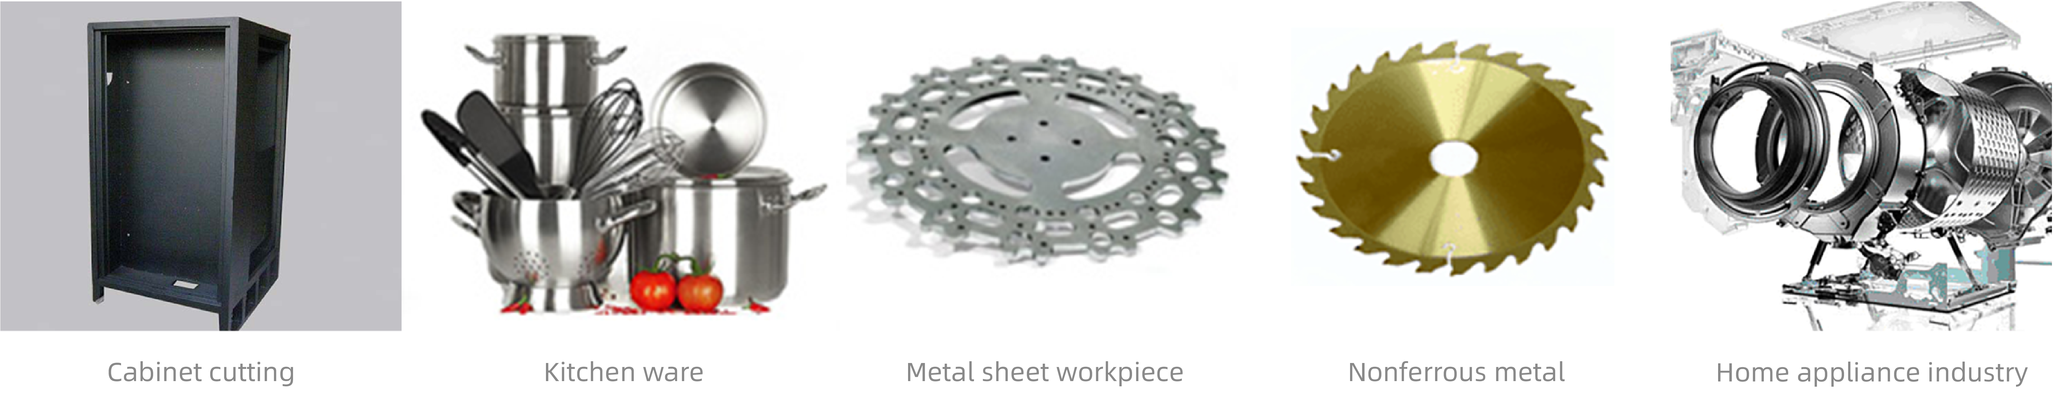
7
Application
Applications at a glance
The 1500w high power fiber laser cutting machine, widely used in fabricating industries of metal workpiece, kitchen utensils, lamps, cabinets and more.
· 第页 ·
www.ray-laser.com

Slide 21
8
Quotation
Quotation Sheet
No. | Machine Name | Model | Qty | Unit Price(¥)
1 | CNC Laser Cutting Machine | TF 3015 Edge -1500W | 1 | 95，000.00
Total sales price
Other terms
Valid | 10 days
Production Time | 15 working days after down payment received
Gross Weight | 2200Kg
Trade terms | EXW Shanghai China
Payment terms | 35%T/Tdown paymentin advance, the balance before delivery
Package terms | With wooden case in 40’ container
Warranty terms | 3 years warranty from the date of bill of lading issued.
Machine Installation and Training service，Fees are not included:
Installation time | 1-2 Engineers 3-8 working days
Installation | The Step by step installation tutorial and online video supported. or our experienced operator at your cost.
Training service | We will provide machine operator and software programming operator training service with gratis condition
· 第页 ·
www.ray-laser.com

Slide 22
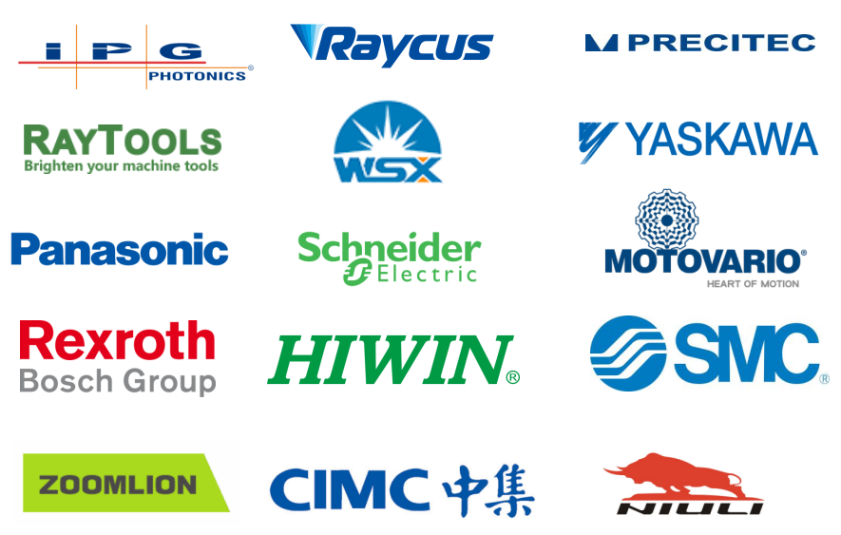
9
Partners and Customers
· 第页 ·
www.ray-laser.com

Slide 23
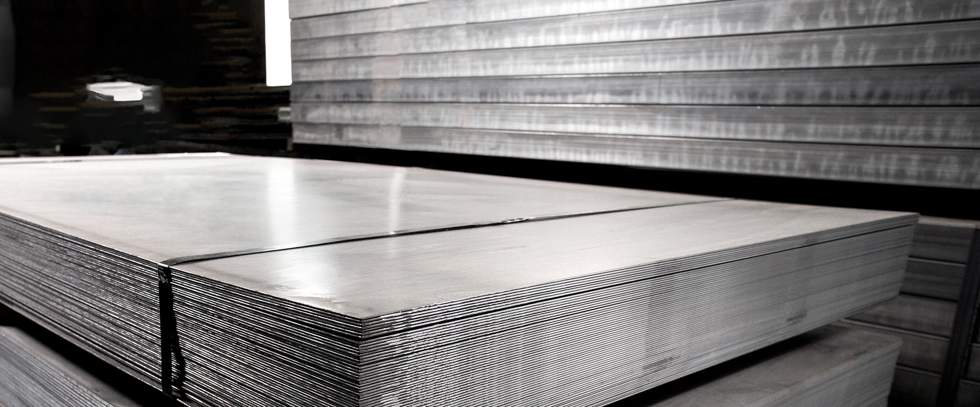


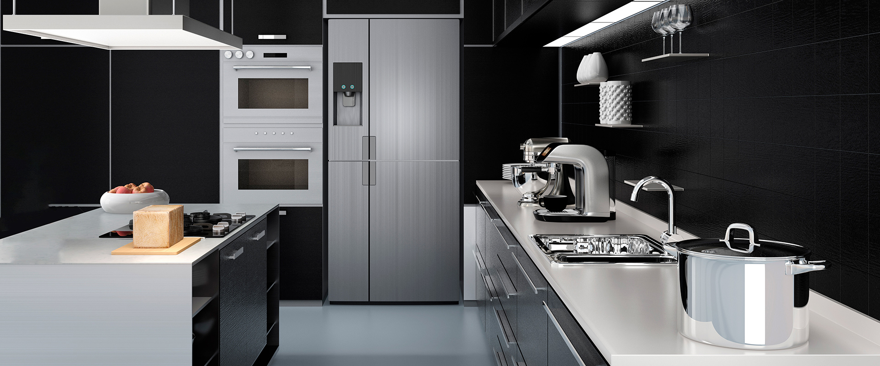
10
Together for the stronger future
At Raylaser, we offer you professional advice and in depth value added support on how you can build your machine step by step.
we can offer you comprehensive advice so that you can take advantage of all production possibilities.
Our service experts are always there for you!
Together we will find the solution that best fits your business development!
· 第页 ·
www.ray-laser.com

Slide 24
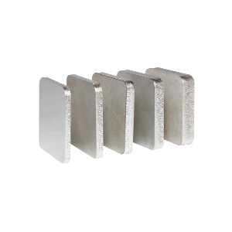
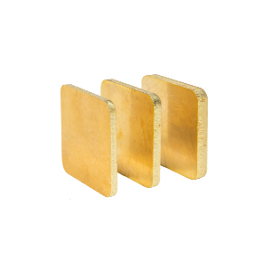
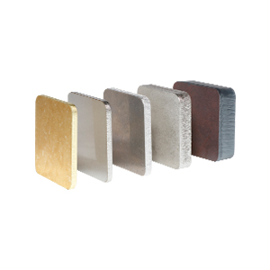
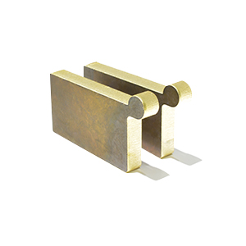
10
Together for the stronger future
Shanghai Raylaser Intelligent Technology Co., Ltd is an international intelligent and automated laser cutting and welding solution provider for automobiles, aviation, medical care, electronics, metal processing, and other laser cutting and welding related industries.
With more than17 years of experience in Laser Cutting, Laser Welding applications, our service cover 180 countries and regions. The global service provide customers with 24/7 timely expert consultancy, technical support and problem solving tips and techniques.
Main products line covering the laser power range from 1.5kW to 60kW, material processed including sheets, tubes, sheet-and-tube integrated laser cutting machines, laser welders, and automation devices. Our products with comprehensive configuration, speed, and precision, high-performance that lead the development of the industry. Also the economical machines with high quality, high performance, high security, and great experience.
We Also offer OEM service for more than 40 manufactures worldwide.
Welcome to Shanghai Raylaser for more OEE, TPM，TQM and life circle solutions and services that matters to raise productivity, increase cut edge quality and reduce operating costs.
1500W Laser Cutting Samples AS Following
1~6 Stainless Steel 3~6 Copper 4~6 Copper 4~10 Metal
· 第页 ·

Slide 25
Focus on Laser Applications
Create Value for Customers
· 第页 ·
www.ray-laser.com

